Slide 1
AUTOMATIC OPTIC NERVE MEASUREMENT (AUTONOMA): A NEW TOOL TO STANDARDIZE THE OPTIC NERVE ASSESSMENT BY TRANSORBITAL SONOGRAPHY
Dr. Andrea Naldi
Department of Neuroscience Rita Levi Montalcini, University of Turin, Italy
and
Neurology Unit and Stroke Unit, San Giovanni Bosco Hospital of Turin, Italy
andrea.naldi@aslcittaditorino.it

Slide 2
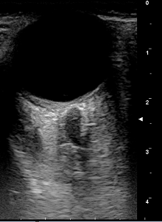
AUTOMATIC OPTIC NERVE MEASUREMENT (AUTONOMA)
INTRODUCTION
B-mode Transorbital Sonography (TOS)
Sangue
Parenchima
Liquor
Non invasive evaluation of the orbit’s structures
Optic Nerve Sheath Diameter (ONSD)
Estimation of intracranial pressure
Optic Nerve Diameter (OND)
Neurodegeneration and inflammation
Diagnosis and Monitoring
Massa

Slide 3
AUTOMATIC OPTIC NERVE MEASUREMENT (AUTONOMA)
INTRODUCTION
Manual assessment
Parenchima
Axial plane
3 mm behind the globe
OND / ONSD
Averaging values
Sangue
Liquor
3mm
ONSD
OND
Affected by operator’s experience
Artifactual images
Inter and Intra-operator variability
Not standardized measurement methods
Reduced reproducibility
Heterogeneity across studies
Misunderstanding of result’s interpretation

Slide 4
AUTOMATIC OPTIC NERVE MEASUREMENT (AUTONOMA)
INTRODUCTION
Computerized automated system for OND / ONSD measurement
Sangue
Parenchima
Reduce operator dependency
Accelerate acquisition time
Mitigate the issue of inter-operator variability
Massa
AUTONoMA
(AUTomatic Optic Nerve MeAsurement)
Completely automatic segmentation of optic nerve and optic nerve sheath in ultrasound B-mode images
No interaction with the user for measurements

Slide 5
AUTOMATIC OPTIC NERVE MEASUREMENT (AUTONOMA)
METHODS
Primary aim
Manual measurement
vs
AUTONoMA
Sangue
Parenchima
Liquor
75 images
30 images from 15 patients with intracranial hypertension
45 images from 23 healthy subjects
Written consent and Ethic Committee
Massa
Expert neurosonologist
One ultrasound portable device (Vivid 7 sonography system, 7-11MHz linear transducer)
Close eyelids; head reclined 20-30°
Images
Workstation
Offline processing

Slide 6
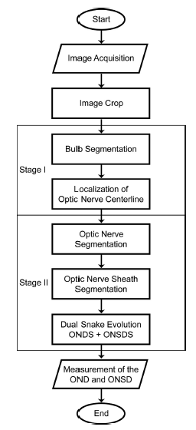
AUTOMATIC OPTIC NERVE MEASUREMENT (AUTONOMA)
METHODS
AUTONoMA Architecture
Sangue
Parenchima
Massa
STAGE II
STAGE I

Slide 7
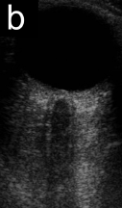
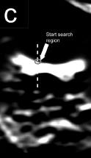
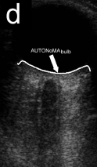
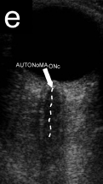
AUTOMATIC OPTIC NERVE MEASUREMENT (AUTONOMA)
METHODS
AUTONoMA Architecture – Stage I
Bulb recognition
Optic nerve centerline
Sangue
Parenchima
Liquor
Massa

Slide 8
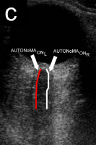
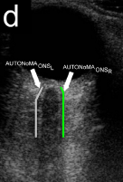
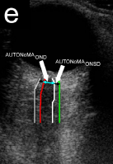
AUTOMATIC OPTIC NERVE MEASUREMENT (AUTONOMA)
METHODS
AUTONoMA Architecture – Stage II
Optic nerve segmentation
Optic nerve sheath segmentation
OND / ONSD calculation
Sangue
Parenchima
Liquor
Massa
3mm
~ 2 seconds

Slide 9
AUTOMATIC OPTIC NERVE MEASUREMENT (AUTONOMA)
METHODS
Manual assessment
Operator 1 – Expert
Operator 2 – Inexpert
Optic nerve centerline
OND / ONSD calculation
Sangue
Liquor
Tracing borders
Massa
3mm
~ 30 seconds

Slide 10
AUTOMATIC OPTIC NERVE MEASUREMENT (AUTONOMA)
METHODS
AIMS
Sangue
Performance evaluation of AUTONoMA
Measurements comparison between AUTONoMa and Operators
Error between AUTONoMA and Operators
Mean error
Mean squared error
Figure of Merit (FoM – overall performance of AUTONOMA)
Inter-operator variability
Liquor
Massa

Slide 11
AUTOMATIC OPTIC NERVE MEASUREMENT (AUTONOMA)
RESULTS
Optic nerve diameter
Sangue
Liquor
Massa
NO statistically differences between AUTONoMA and Operators
(AUTONoMA tends to underestimate the measures)

Slide 12
AUTOMATIC OPTIC NERVE MEASUREMENT (AUTONOMA)
RESULTS
Optic nerve sheath diameter
Sangue
Liquor
Massa
NO statistically differences between AUTONoMA and Expert operator
Inexpert operator measurements were statistically (p<0.05) lower compared to AUTONoMA and Expert operator

Slide 13
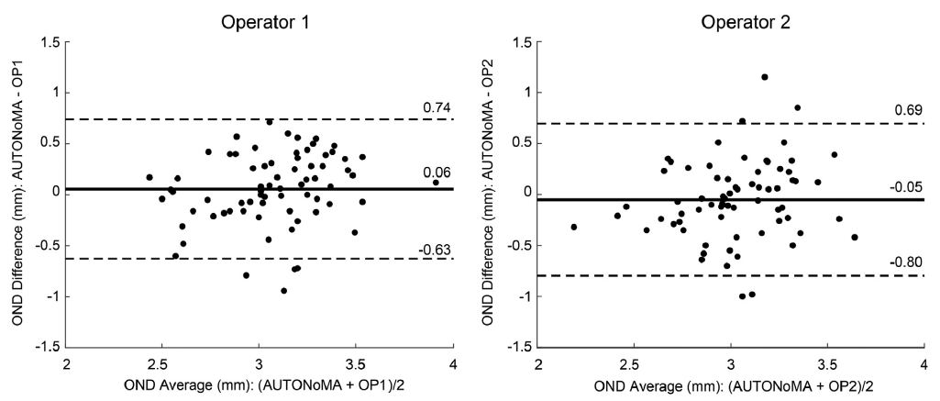
AUTOMATIC OPTIC NERVE MEASUREMENT (AUTONOMA)
RESULTS
Optic nerve diameter
Agreement AUTONoMA vs Expert / Inexpert operator
Sangue
Liquor
Massa

Slide 14
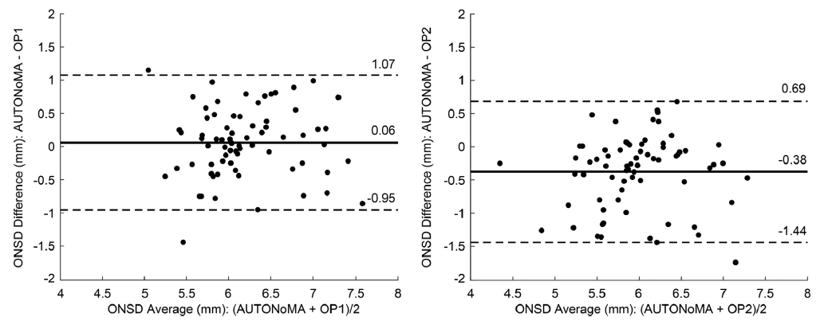
AUTOMATIC OPTIC NERVE MEASUREMENT (AUTONOMA)
RESULTS
Optic nerve sheath diameter
Agreement AUTONoMA vs Expert / Inexpert operator
Sangue
Liquor
Massa

Slide 15
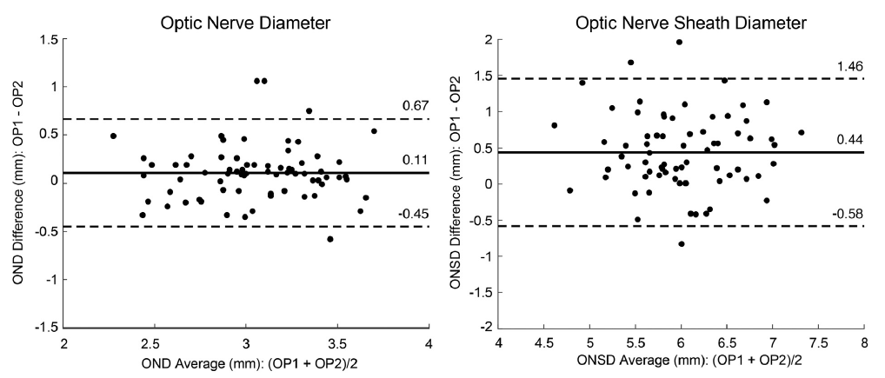
AUTOMATIC OPTIC NERVE MEASUREMENT (AUTONOMA)
RESULTS
OND / ONSD
Inter-operator agreement
Sangue
Liquor
Massa
AUTONoMA
NO measurement variability

Slide 16
AUTOMATIC OPTIC NERVE MEASUREMENT (AUTONOMA)
DISCUSSION
AUTONoMA
Sangue
Liquor
No differences between AUTONoMA and Expert Operator
(both for OND and ONSD measurements)
Good agreement between Operators and AUTONoMA
Fast and simultaneous OND/ ONSD evaluation
(2 seconds per image vs 30s of the manual measurement;
single measurement vs averaging of values)
Completely automatic and independent from the user (no measurement variability both for OND/ONSD)
Massa

Slide 17
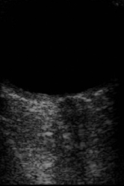
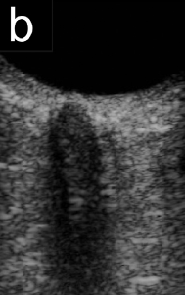
AUTOMATIC OPTIC NERVE MEASUREMENT (AUTONOMA)
DISCUSSION
AUTONoMA - Limitations
Sangue
Liquor
Correctly processed 71 out of 75 images (95%)
Images have to be CLEAR
Perpendicular direction of the optic nerve
Adequate differences in echogenicity of the structures
Massa
Larger sample
Subgroup analysis not available
Insufficient intensity difference between the hypo-echogenicity of the optic nerve and the subarachnoid space
Excessive hyper-echoic sorrounding the subarachnoid space

Slide 18
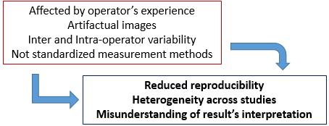
AUTOMATIC OPTIC NERVE MEASUREMENT (AUTONOMA)
CONCLUSION
Valuable tool for OND and ONSD measurements
Faster than manual evaluation
No variability of measurements
AUTONoMA
Sangue
Liquor
Manual assessment
Massa
Reduce the operator dependency
Accelerate acquisition time
Mitigate the issue of operator variability
Standardize measurements
Higher reproducibility among studies

Slide 19
AUTOMATIC OPTIC NERVE MEASUREMENT (AUTONOMA)
CONCLUSION
Thanks for your attention
For more details:
Sangue
Liquor
Massa
Andrea Naldi, M.D.
Department of Neuroscience
Rita Levi Montalcini
University of Turin - Italy
andrea.naldi@aslcittaditorino.it
Piergiorgio Lochner, M.D., PhD
Department of Neurology
Saarland University Medical Center
Homburg – Germany
piergiorgio.lochner@uks.eu
Kristen M. Meiburger
PoliToBIOMed Lab
Department of Electronics and
Telecommunications, Politecnico of Turin
Turin – Italy

